Slide 1
Data Quality

Slide 2
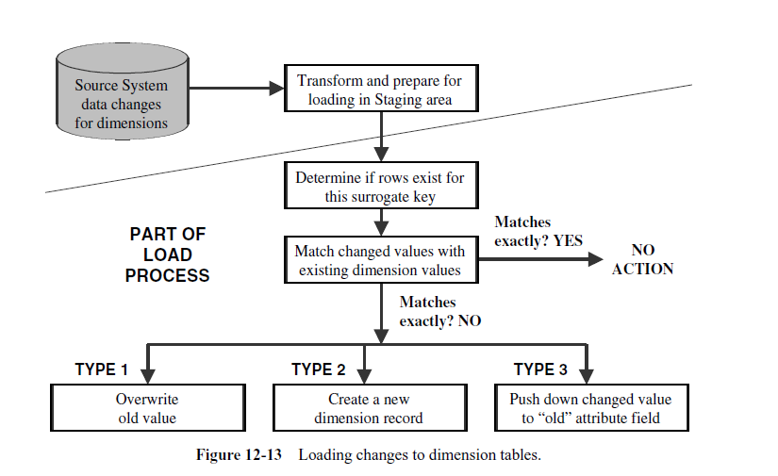
Loading the fact tables and dimension tables

Slide 3
The procedure for maintaining the dimension tables includes two functions:
The initial loading of the tables
Applying the changes on an ongoing basis. Let us consider two issues.
Incremental extracts for fact tables
Consist of new transactions
Consist of update transactions
Use database transaction logs for data capture
Incremental loads for fact tables
Load as frequently as feasible
Use indexes
Apply parallel processing techniques

Slide 4
Data Quality
What is Data: An abstraction/representation/
description of something in reality
What is Data Quality: Accuracy + Data must serve its purpose/user expectations

Slide 5
Indicators of quality of data
Accuracy: Correct information, e.g., address of the customer is correct
Domain Integrity: Allowable values, e.g., male/female
Consistency: The content and its form is same across all source system, e.g., product code of a product ABC in one system is 1234 then in other system it must be 1234 for that particular product

Slide 6
Indicators of quality of data (Cont.)
No Redundancy: Data is not redundant, if for some reason for example efficiency the data is redundant then it must be identified accordingly
Completeness: There are no missing values in any field
Conformance to Business rules: Values are according to the business constraints, e.g., loan issued cannot be negative
Well defined structure: Whenever the data item can be divided in components it must be stored in terms of components/well structure, e.g., Muhammad Ahmed Khan can be structured as first name, middle name, last name. Similar is the case with addresses

Slide 7
Indicators of quality of data (Cont.)
Data Anomaly: Fields must contain that value for which it was created, e.g., State field cannot take the city name
Proper Naming convention
Timely: timely data updates as required by user
Usefulness: The data elements in data warehouse must be useful and fulfill the requirements of the users otherwise data warehouse is not of any value

Slide 8
Indicators of quality of data (Cont.)
Entity and Referential Integrity: Entity integrity means every table must have a primary key and it must be unique and not null. Referential integrity enforces parent child relationship between tables, you can not insert a record in child table unless you have a corresponding record in parent table

Slide 9
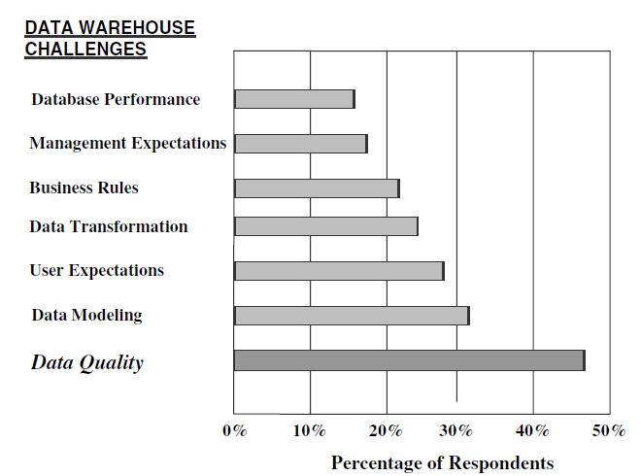
Problems due to quality of data
Businesses ranked data quality as the biggest problem during data warehouse designing and usage

Slide 10
Types of Data Quality Problems
Dummy values: For example, to pass a check on postal code, entering dummy or not precise information such as 4444 (dummy) or 54000 for all regions
Absence of data values: For example not a complete address
Unofficial use of field: For example writing comments in the contact field of the customer

Slide 11
Types of Data Quality Problems
Cryptic Information: At one time operation system was using ‘R’ for “remove” then later for “reduced” and some other time point for “recovery”
Contradicting values: compatible fields must not contradict, e.g., two fields ZIP code and City can have values 54000 and Lahore but not some other city name for ZIP code 54000

Slide 12
Types of Data Quality Problems
Violation of business rule: Issued loan is negative
Reused primary keys: For example, a business has 2 digit primary key. It can have maximum 100 customers. When a 101th customer comes the business might archive the old customers and assign the new customer a primary key from the start. It might not be a problem for the operation system but you need to resolve such issues because DW keeps historical data.

Slide 13
Types of Data Quality Problems
Non-unique identifiers: For example different product codes in different departments
Inconsistent values: one system is using male/female to represent gender while other system is using 1/0
Incorrect values: Product Code: 466, Product Name: “Crystal vas”, Height:”500 inch”. It means that product and height values are not compatible. Either product name or height is wrong or maybe the product code as well

Slide 14
Types of Data Quality Problems
Erroneous integration: A person might be a buyer or seller to your business. Your customer table might be storing such person with ID 222 while in seller table it might be 500. In data warehouse you might need to integrate this information. The persons with IDs 222 in both tables might not be same

Slide 15
Data Cleansing Decisions/ Issues
Which Data to Cleanse
The cost of cleaning up all data in the data warehouse is enormous.
By ignoring the cleansing of unimportant data as long as all the important data is cleaned up.
Where to Cleanse
staging area
Cleansing the data in the staging area is comparatively easy.
But Data pollution will keep flowing into the staging area from the source systems.
The source systems will continue to suffer from the consequences of the data corruption.
Source System
If you attempt to cleanse the data in the source systems, you are taking on a complex, expensive, and difficult task.

Slide 16
Data Cleansing Decisions/ Issues
How to Cleanse
Vendor tools
In-house programming
How to Discover the Extent of Data Pollution
Make a list that reflects the sources of pollution found in the environment, then determine the extent of the data pollution with regard to each source of pollution
Setting Up a Data Quality Framework
Most companies serious about data quality pull all these factors together and establish a data quality framework. Essentially, the framework provides a basis for launching data quality initiatives. It embodies a systematic plan for action. The framework identifies the players, their roles, and responsibilities.

Slide 17
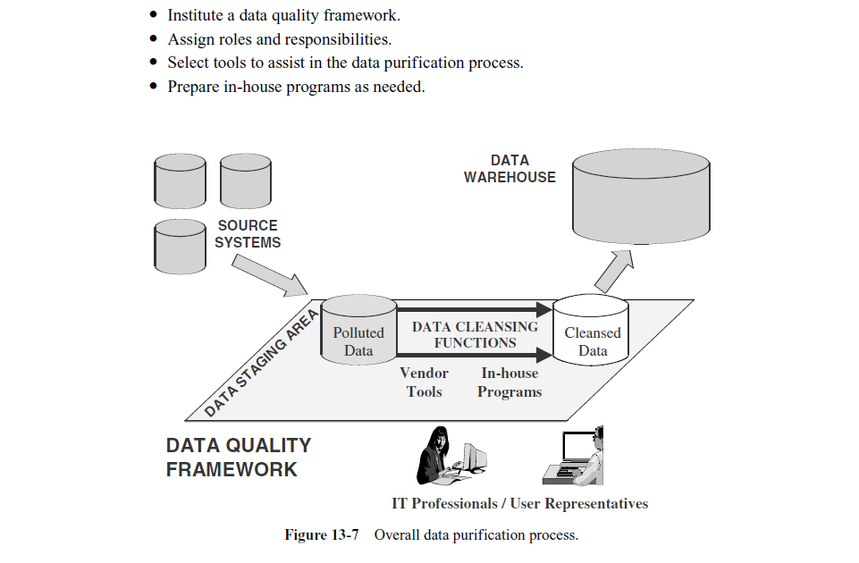

Slide 18
